Slide 1
Project Title : Retail Case Study
Name : Divya Gupta
Date: 23rd June,2025

Slide 2

Business Context

Slide 3
Business Context
🏢 Client Overview
The client is a leading retail chain in India with a widespread network of physical stores and possibly online channels. Operating in a highly competitive and rapidly evolving market, the client faces challenges in understanding changing consumer behaviors, optimizing sales channels, and maximizing product performance.
📈 Business Need
To maintain their leadership in the retail industry and stay ahead of competitors, the client has chosen to partner with AnalytixLabs for strategic data analytics support. Their goal is to leverage Point of Sale (POS) data — which includes customer transactions, product sales, channel information, and more — to extract actionable insights that can drive better decision-making and fuel business growth.
✅ Reason Behind This Survey
To gain a deeper understanding of customer behavior and preferences.
To evaluate product and category performance across stores and channels.
To identify high-performing and underperforming stores and regions.
To uncover sales trends and the impact of seasonality.
To measure key business metrics like customer retention, repeat rate, and churn(many customers are leaving).
To find cross-selling and upselling opportunities.
To segment customers for targeted CRM and marketing campaigns.
To support strategic planning for the upcoming year.
To enhance overall business performance and profitability using analytics.

Slide 4

Problem Statement

Slide 5
Problem Statement
The client, a leading retail chain in India, is currently lacking data-driven visibility into its business performance and customer behaviors. Despite having large volumes of point-of-sale (POS) data across multiple stores and channels, there is no structured approach to extracting actionable insights that can guide strategic decisions.
The client seeks to understand customer, product, store, and channel behaviors to improve marketing effectiveness, customer retention, and sales growth. Currently, there is limited clarity on key metrics such as repeat rate, product category performance, store-level sales patterns, and seasonality impact, which hinders the ability to plan campaigns, CRM initiatives, and sales strategies effectively.
To address this, the analytics team at AnalytixLabs has been tasked with performing in-depth analysis on:
Product and category performance
Customer behavior and segmentation
Channel and store-level trends
Sales patterns, seasonality, and cross-selling opportunities
Customer satisfaction
The goal is to provide a comprehensive data-driven understanding of the business that will help the client define and implement effective CRM, marketing, and sales strategies for the upcoming year and beyond.

Slide 6
Technology Stack & Tool Usage
Excel
Used for initial data cleaning and formatting.
SQL (Structured Query Language)
Imported and connected raw data tables
Handled data transformation, filtering, joining, and aggregation
Identified and resolved data discrepancies and inconsistencies.
Power BI Desktop
Created interactive dashboards and reports
Visualized KPIs, sales trends, product/category performance, and customer insights
Enabled user-friendly views for exploring data patterns
PowerPoint (PPT)
Documented business context, problem statement, and key findings
Presented insights, analysis outcomes, and strategic recommendations
Final deliverable.

Slide 7
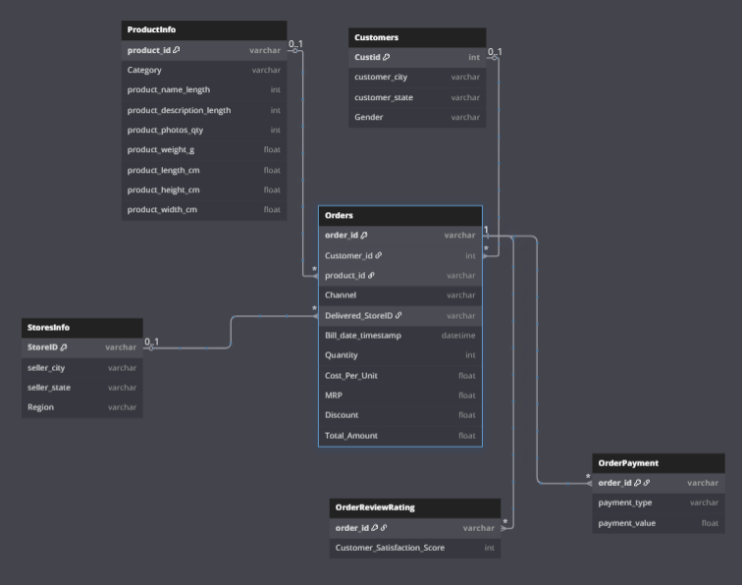
ER - Diagram

Slide 8
Relationship – Primary Key , Foreign Key
Table | Primary Key | Foreign Key
Customer | CustId | -
Store Info | StoreId | -
Product Info | ProductId | -
Orders | OrderId | Customer_id → Customers, product_id → ProductInfo, Delivered_StoreID → StoresInfo
Order Payment | OrderId | Order_id → Orders
Order Review Rating | OrderId | Order_id → Orders

Slide 9

Data Description

Slide 10
.
Customer
Description: Contains demographic and location-based information about customers.
Key Features:
Cust_id : Unique identifier for each customer(Primary Key).
Gender : Indicates the gender of the customer, typically categorized as Male or Female.
Customer_state , Customer_city : Geographic Details
Purpose : Used to identify profile of the customer and can be joined with order using Cust_Id.
Importance : (Customer_state) Regional segmentation, targeting, and marketing.
Order
Description: Contains order-related information, acting as a central transactional table.
Key Feature:
Order_id : Unique Identifier for each order(Primary Key).
Product_Id : Foreign Key linking to the ProductInfo.
Bill_date_timestamp : Date of order placed with the timings.
Deliverd_store_id : Foreign Key linking to StoreInfo.

Slide 11
Channel : Sales channel through which the order was placed.
Quantity : Number of units ordered for a particular product in the transaction.
Discount : Discount applied to the product
MRP : The listed price for the product, per unit.
Cost/unit : Internal cost price incurred by the company for each unit of the product.
Total Amount : Final amount paid by the customer for the order (after discount), including all units.
Purpose: Tracks each order and its origin. It is a bridge between customers, products, payments, and reviews.
Importance : Time-series trend, seasonal analysis.
Order Payment
Description: Captures payment-related data for orders.
Key Features :
order_id : Foreign Key referencing orders.
payment_type : Method used (Credit Card, Debit Card,etc)
payment_value : Amount paid.
Purpose : Used for analyzing revenue, preferred payment method and financial trends.
Importance : Revenue calculation, customer value.

Slide 12
OrderReview_Ratings
Description: Contains customer feedback post-purchase.
Key Features :
Order_id : Foreign Key referencing Order.
Customer_Satisfaction Score : Rating score given by the customer(usually 1-5).
Purpose : Helps analyze customer satisfaction , detect issues, and evaluate store or product performance.
Importance : Customer satisfaction metric.
Product_Info
Description: Details about the products listed in the store, including category, content quality metrics (e.g., name and description length), number of product images, and physical dimensions.
Key Features :
Product_id : Unique identifies (Primary Key).
Category : Product type/category.
Product_name_length : Number of characters in the product name.

Slide 13
product_description_lenght: Number of characters in the product description.
product_photos_qty: Number of product images provided.
product_weight_g: Weight of the product in grams.
product_length_cm: Length of the product in centimeters.
product_height_cm: Height of the product in centimeters.
product_width_cm: Width of the product in centimeters.
Purpose : Supports product-level analysis such as catalog quality evaluation, shipping dimension planning, and category-wise product profiling. It helps identify trends in product presentation and logistics readiness.
Importance:
Helps assess the quality of product listings via name, description, and images.
Provides critical logistics data for packaging and delivery.
Useful for filtering bulky vs. lightweight items by category.
Supports visual merchandising analysis and customer engagement insights.

Slide 14
Store Info
Description: Metadata about the stores fulfilling orders.
Key Features :
seller_city, seller_state : Store location details.
store_id : Unique identifier(Primary Key)
region : Specifies the geographical region (e.g., South, North, West) where the store is located, useful for regional performance and delivery analysis.
Purpose : Enables performance evaluation of sellers , delivery analysis and geographic insights.
Importance : Geographical performance and logistics planning.

Slide 15

Data discrepancies /Data Inconsistencies identified using SQL

Slide 16
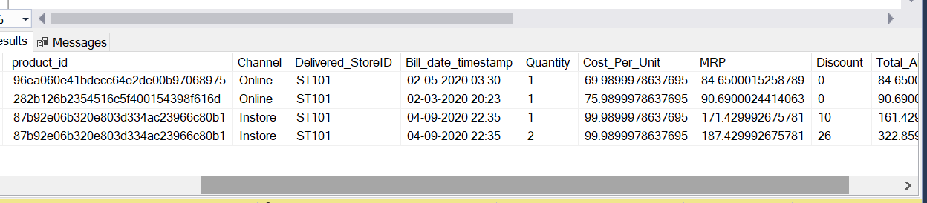
Data discrepancies /Data InConsistencies
Invalid Billing Dates in Orders
Issue: Some orders were outside the valid range How I Cleaned it :
Checked Bill_date_timestamp for invalid entries
Deleted orders outside 2021-09-01 to 2023-10-31
Total 4 rows were found.
Bill_date_timestamp year given in this rows was 2020

Slide 17
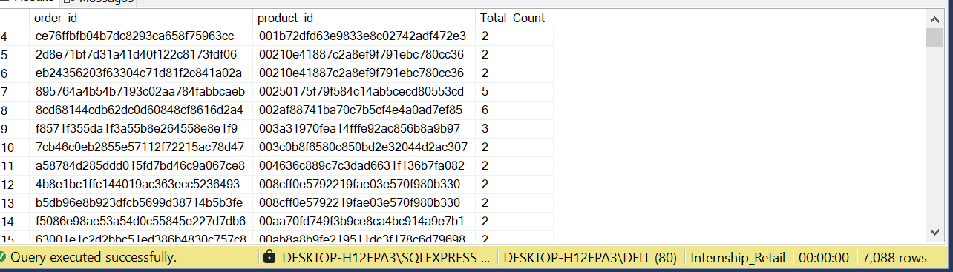
2. Duplicate Order-Product Rows
Issue: Multiple rows with same Order_ID + Product_ID How I cleaned it:
Used ROW_NUMBER() to keep row with highest quantity
Deleted the remaining duplicates Result: Unique Order_ID + Product_ID combination retained SQL Technique: ROW_NUMBER() OVER (PARTITION BY...)

Slide 18
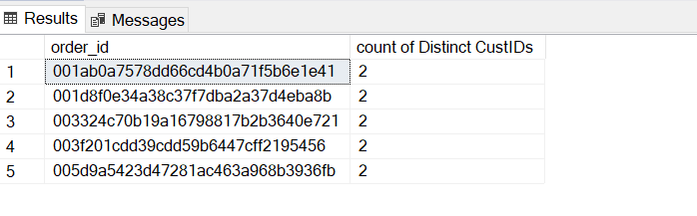
3. Multiple Customers for Same Order
Issue :
Some Order_IDs were linked to more than one Customer_ID.
This is logically incorrect, because each order should belong to only one customer.
This can happen due to:
Data entry errors
System sync issues
Duplicate merges from different sources
How I Cleaned it :
Step 1: For each duplicate Order_ID, I checked which Customer_ID had the highest Total_Amount (assuming that is the correct one).
Step 2: I built a reference mapping with the correct Customer_ID per order.
Step 3: I updated the main Orders table and replaced all incorrect customer entries with the correct one.

Slide 19
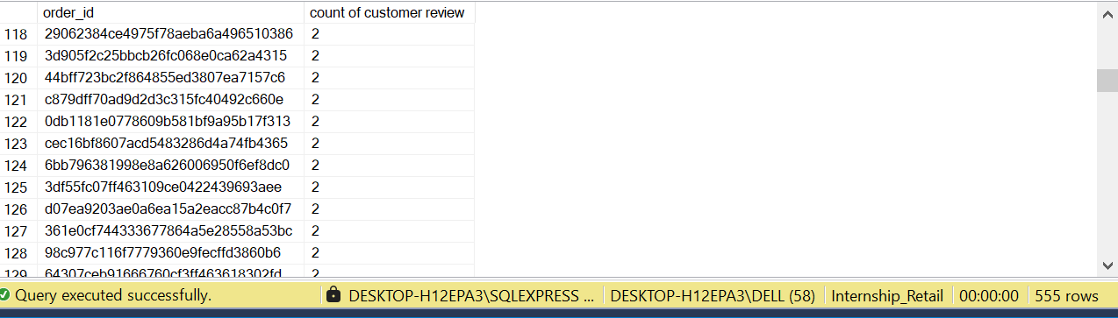
4. Multiple Reviews per Order
Issue :
Some Order_IDs had more than one customer satisfaction review.
This occurred due to:
Duplicate survey submissions
Multiple reviews logged for the same order.
As a result, each order had multiple Customer_satisfaction _score , leading to confusion during analysis.
How I Cleaned It:
Step 1: For each Order_ID with multiple scores:
I calculated the average Customer Satisfaction Score.
Step 2: I created a new cleaned review table called OrderReviewRating_Cleaned.
This table had only one row per Order_ID with the correct average score.

Slide 20
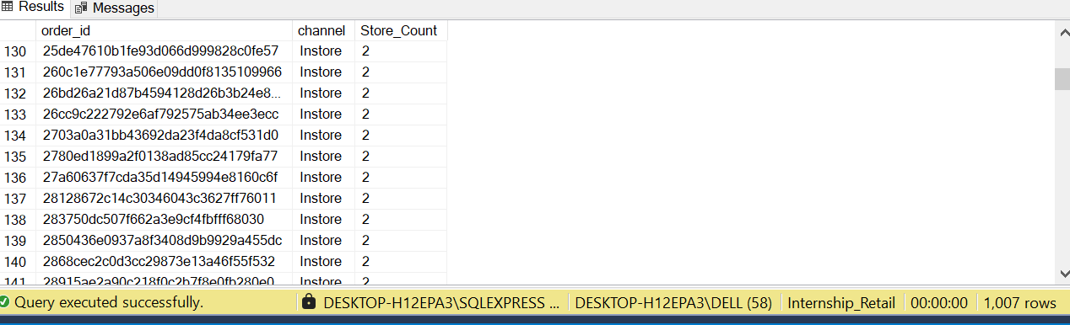
5.Multiple StoreIDs per Order
Issue:
Some Order_IDs were linked to more than one Delivered_StoreID.
This typically happened due to:
Data syncing issues from multiple sources
Late delivery updates overriding earlier records
System errors during store assignment
How I Cleaned It:
For each order with multiple store entries:
I ranked the store entries using the latest billing timestamp (most recent delivery).
Selected only the most recent Delivered_StoreID as the correct one.
Updated the Orders table so that each Order_ID now has only one associated store, which is the latest one based on billing time.

Slide 21
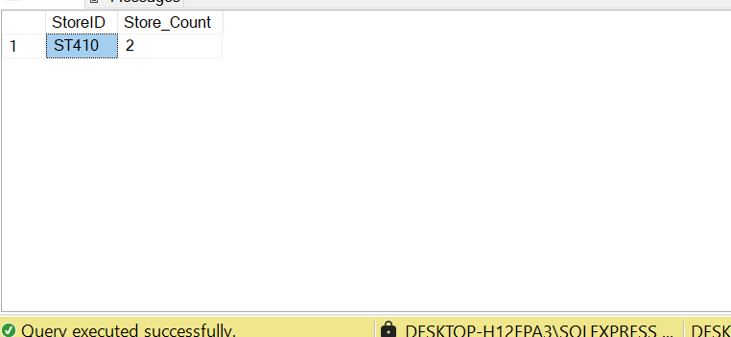
6. Duplicate Store IDs
Issue :
In the StoreInfo table, some StoreID appeared more than once.
Duplicate entries had the same StoreID but might vary slightly in other columns like city or state due to:
Manual data entry errors
Inconsistent data loading from different sources
How I Cleaned It:
Applied a ranking logic to identify which rows were duplicate for each StoreID.
Retained only one entry per StoreID (first occurrence).
Deleted all rows where the ranking number was greater than 1, effectively removing duplicate records.

Slide 22
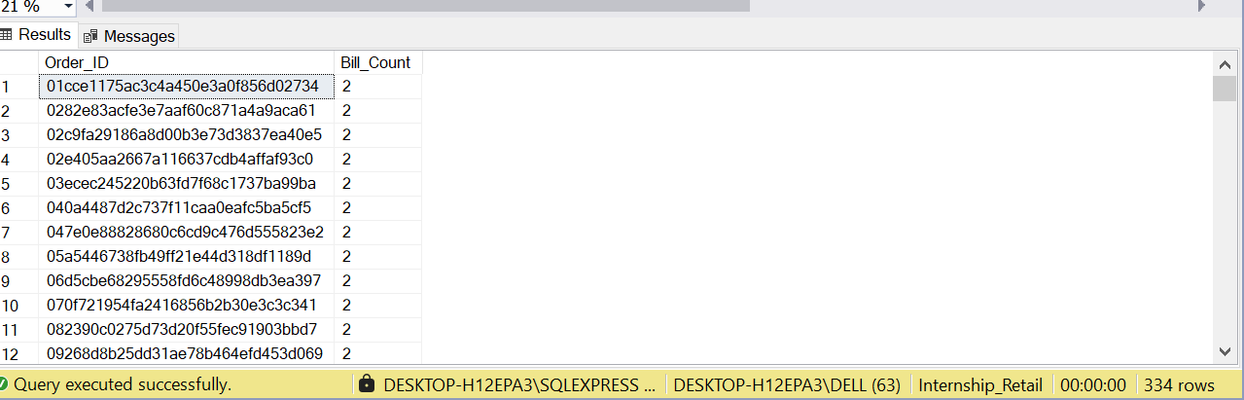
7. Multiple Billing Timestamps
Issue :
Some Order_IDs had multiple Bill_date_timestamp values.
This happened because:
Order records were duplicated across different systems
Partial updates happened at different times
Billing timestamps were not standardized
How I Cleaned It:
First, I identified orders that had more than one timestamp associated with them.
Then, for each affected Order_ID, I selected the earliest billing date (the true or first recorded transaction date).
I updated all records of that order to reflect this consistent earliest billing timestamp.

Slide 23
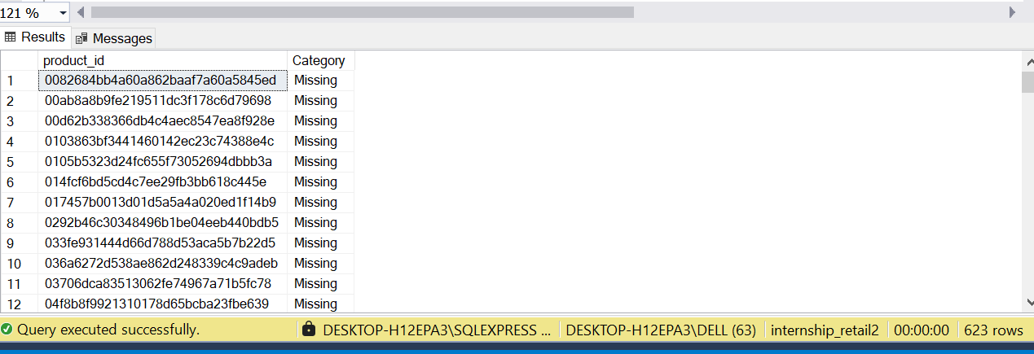
8. Missing Product Categories
Issue Identified:
In the ProductInfo table, some products had the category value as #N/A.
This usually happens when:
Data is exported from Excel or external systems
Product categories are not assigned at the time of entry
Errors occur during import or merge processes
How I Cleaned It:
Identified all rows in ProductInfo where the category was #N/A.
Replaced #N/A with a clear, consistent label: 'Missing‘(there were 623 rows)
This helped in:
Tagging uncategorized products uniformly
Including them in analysis without breaking reports or charts.

Slide 24
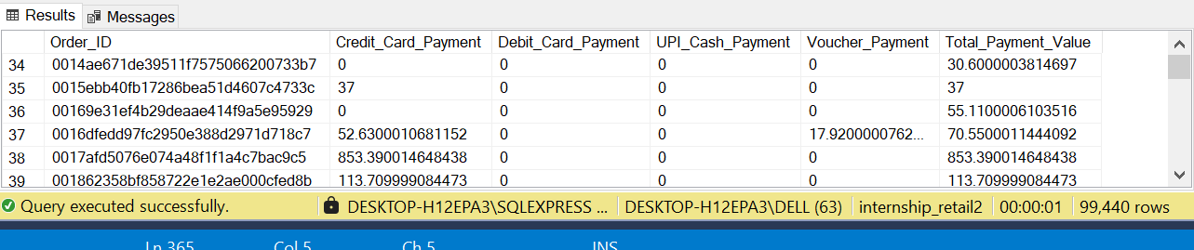
9. Cleaning Payment Details
Issue Identified:
In the original OrderPayment table, each payment type (Credit Card, UPI, etc.) was stored in a separate row for the same Order_ID.
So, a single order had multiple rows like:
Row 1: Order_ID = 101, Payment Type = Credit Card, Amount = ₹500
Row 2: Order_ID = 101, Payment Type = UPI, Amount = ₹200
This row-wise format made the data hard to analyze.
How I Cleaned It:
I transformed (pivoted) the dataset so that each Order_ID appears only once.
All payment types were turned into separate columns:
Credit_Card_Payment
Debit_Card_Payment
UPI_Cash_Payment
Voucher_Payment
I calculated the total payment value per order and created a new table called Cleaned_OrderPayment.

Slide 25

Exploratory Data Analysis

Slide 26
Metrics
1.Total Customer : 92935
2.Male Customer : 28033
3.Female Customer : 64902
4.Average Sale Per Customer : 158.18
5.Average Discount Per Customer : 5.45
6.Average Profit Per Customer : 22.13
7.Transaction Per Customer : 1.0009
1.Total Order Placed : 93022
2.Online Customer : 1516
3.Phone Customer : 9743
4.Instore Customer : 81763
5.Total Revenue : 14.7M
6.Total Profit : 2.1M
7.Avrg, Max & Min Profit : 22.1104,1794.96 & 0
8.Average Order Value : Rs158.04
9.Average Profit per Order : Rs 22.11
10.Average Discount per Order : 5.00
11.Average Quantity Per Order : 1
Customer Level Metrics:
Order Level Metrics:

Slide 27
Metrics
1.Total Products : 32951
2.Average Price for Products : Rs496.282
3.Total Stores : 37
4.Stores by Region(North,South,East,West) : 8, 25, 1, 3
5.Average Satisfaction Score : 3.92
Product / Store Level Metrics:

Slide 28
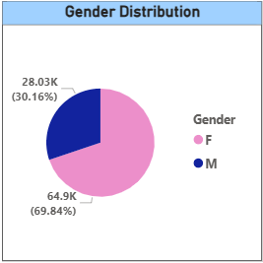
Customer Analysis
1.Customer Count by Gender
Insight: Gender distribution of customers.
Business Value: Helps in targeted marketing and personalization
Visuals: Pie Chart

Slide 29
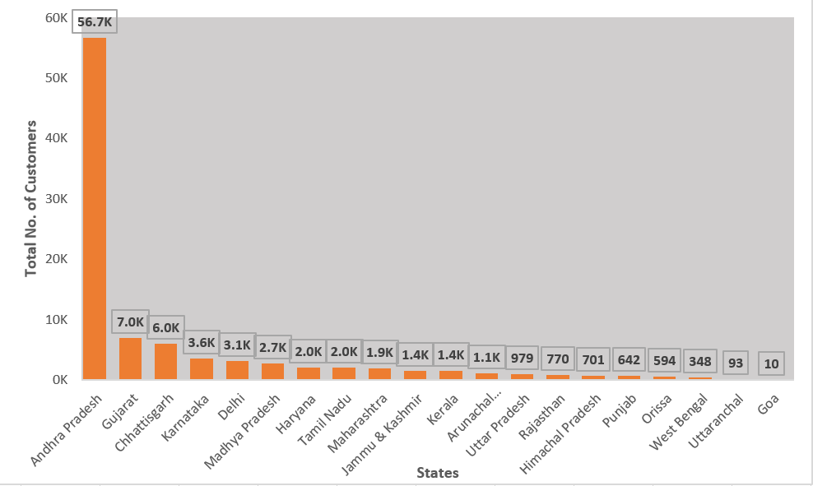
2.Customer Count by State
Insight: Where most customers are located.
Business Value: Supports logistics and location-specific campaigns
Visuals :Column Chart

Slide 30
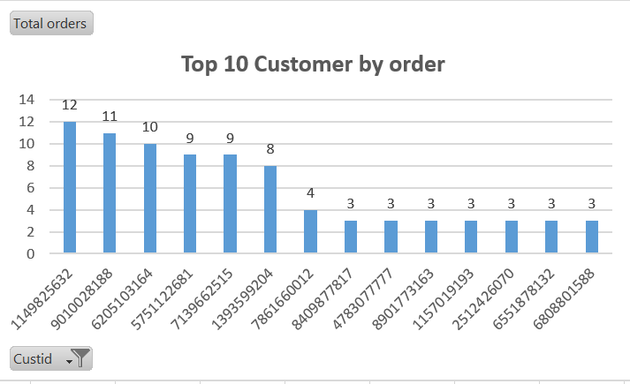
3.Top 10 Customers by Total Orders
Insight: Most active buyers.
Business Value: Loyalty programs can target these users.
Visuals : Column Chart

Slide 31
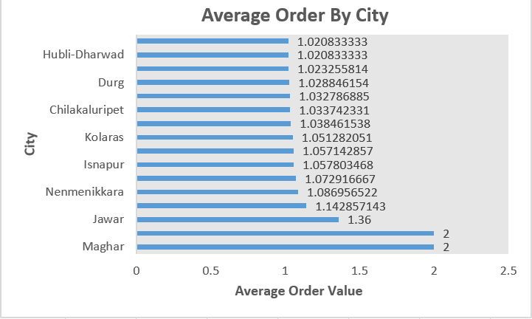
4.Average Order by City:
Insight: Cities like Maghar and Jawar show significantly higher average orders per customer.
Business Value: Focus on cities with higher average orders to increase sales and keep customers loyal.
Visuals :Bar Chart

Slide 32
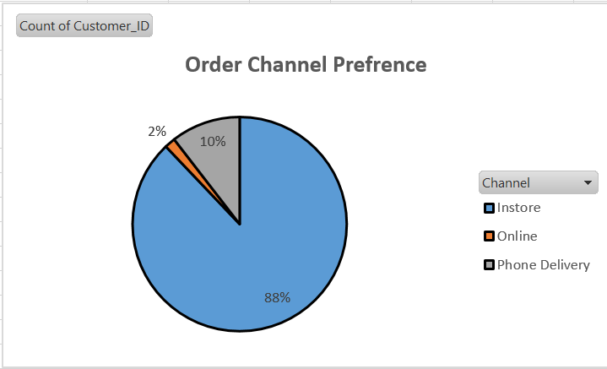
4.Order Channel Preference Segmentation
Insight: Online, in-store, or phone order preference customer.
Business Value: Invest in the right sales channels.
Visuals :Pie Chart

Slide 33
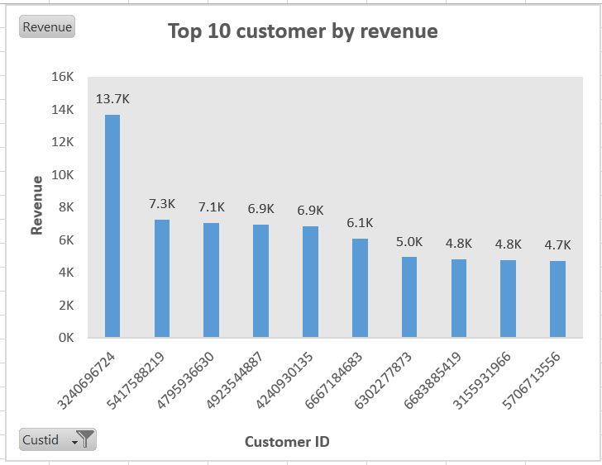
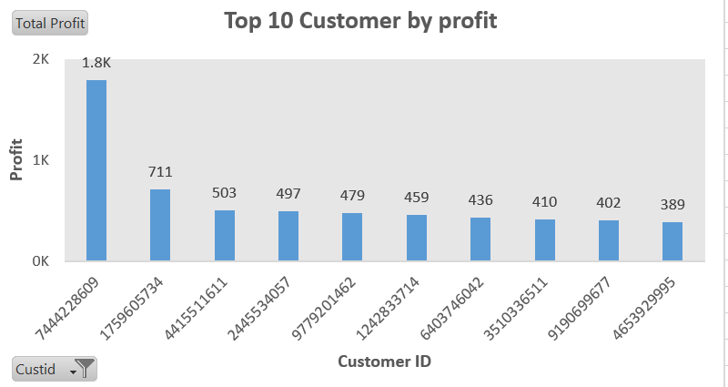
5.Top 10 Customers by Revenue
Insight: Highest revenue generating customers.
Business Value: Useful for VIP customer programs.
Visuals : Column Chart
6.Top Customers by Profit
Insight: Customers giving highest profit margins.
Business Value: Prioritize profitable segments.
Visual : Column Chart

Slide 34
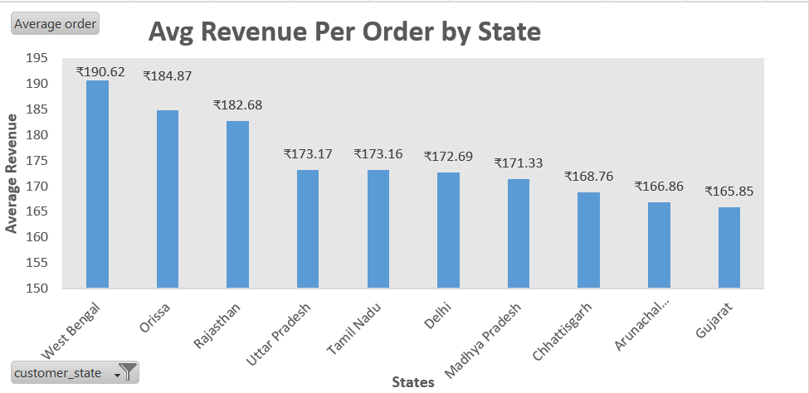
7.Average Revenue Per Order by State
Insight: Where customers spend more per order.
Business Value: Revenue potential by state.
Visuals : column or map chart

Slide 35
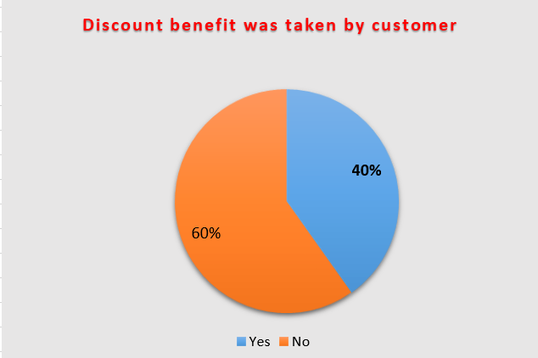
8. How many customers have used discounts
Insight: Around 40% of customers utilized discounts, showing potential to boost retention through targeted promotions.
Business Value: Helps evaluate the effectiveness of discount strategies on customer engagement.
Visuals : Pie chart

Slide 36
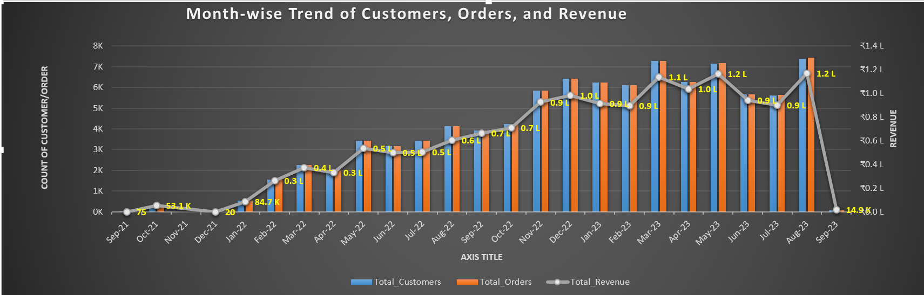
9.Monthly Summary of Customers, Orders, and Revenue:
Insights: Identifies peak and low-performing months to plan better marketing and resource allocation.
Business Value : Helps track customer activity, order volume, and revenue growth over time.
Visuals : Combo Chart

Slide 37
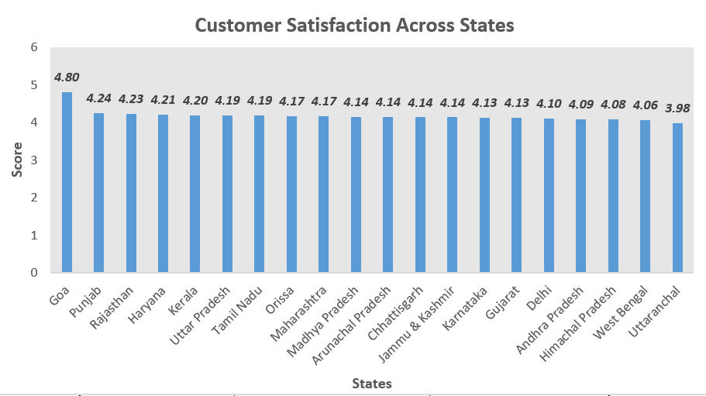
10.Average Satisfaction by State
Insight: How happy customers are in different states.
Business Value: Regional service quality.
Visuals: Column Chart

Slide 38
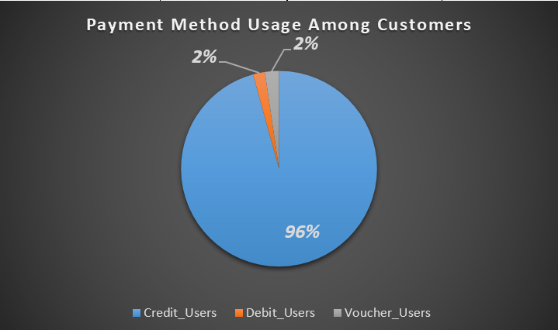
11. Distribution of Payment Method Users
Insight : Most customers prefer debit/credit cards over vouchers, indicating a shift toward digital payment behavior.
Business Value: Helps identify preferred payment methods to optimize promotions and partnerships.
Visuals: Pie Chart

Slide 39
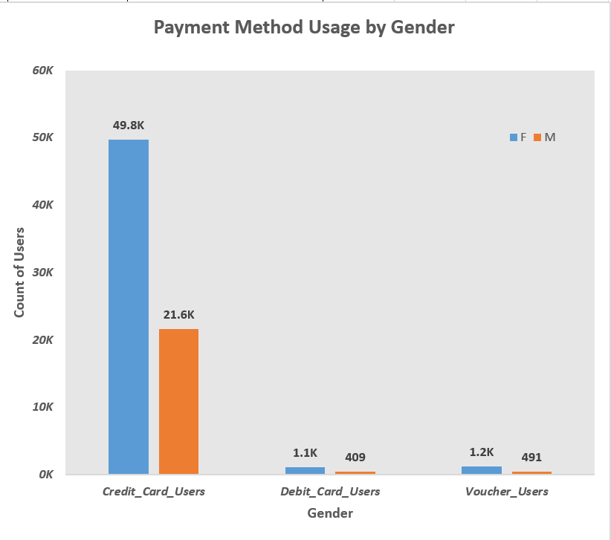
12. Payment Type Distribution by Gender
Insight :Females use credit cards more than males; other methods are less used by both..
Business Value : Understand which payment method is popular among males and females..
Visuals : Clustered Column Chart

Slide 40
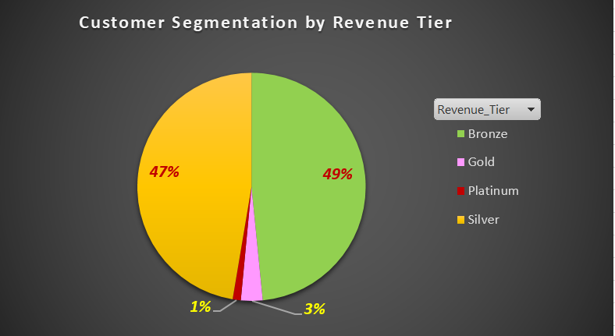
13. Customer Tiering Based on Revenue
Insight :Most customers fall into the Silver and Bronze tiers, indicating scope to upsell and improve customer value.
Business Value :Helps prioritize high-value customers for premium services and loyalty programs.
Visuals : Pie Chart

Slide 41
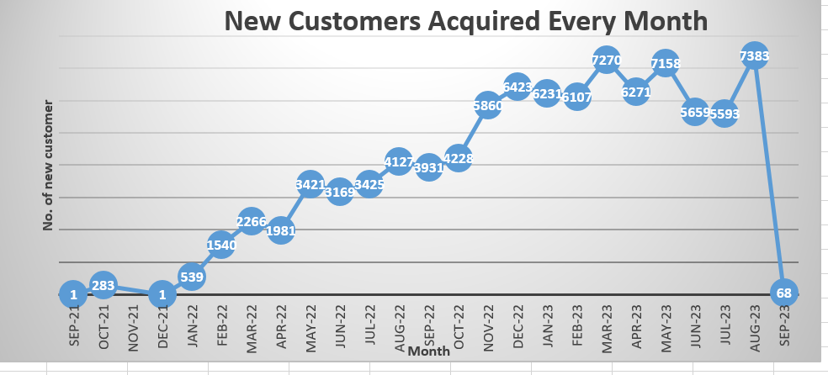
10.New Customer Acquired every month
Insights : Customer acquisition varied monthly, with peak sign-ups in high-performing months.
Business value: Helps optimize marketing and drive growth in low acquisition periods
Visuals: Line Chart

Slide 42
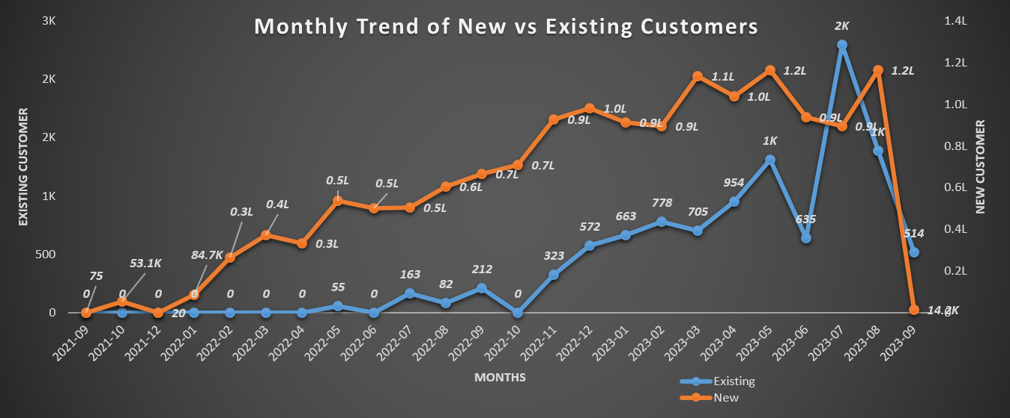
11. Trend Analysis of New and Existing Users
Insights :New customers consistently contribute higher monthly revenue than existing customers.
Business value: Highlights strong acquisition performance and an opportunity to improve retention strategies for long-term growth
Visuals: Line Chart

Slide 43
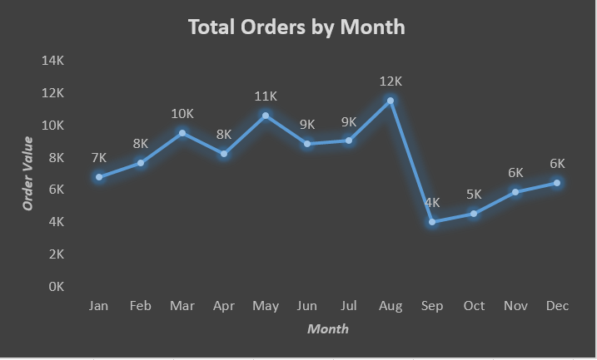
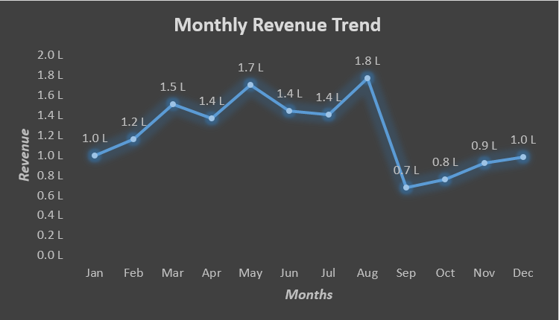
Order Analysis
1.Daily Order Trend
Business Value: Tracks day-to-day sales performance to identify demand patterns and operational peaks.
Order Insight : Spikes on weekends show higher customer engagement on specific days.
Revenue Insight : Consistent revenue dips mid-week may indicate low weekday footfall or less marketing push.

Slide 44
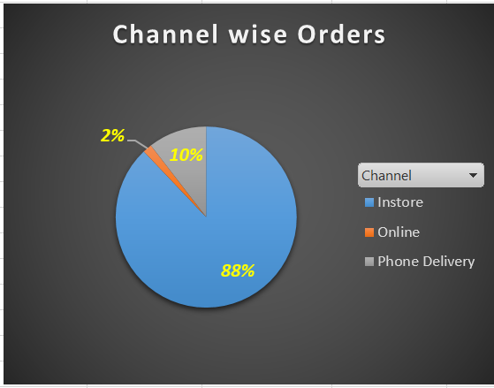
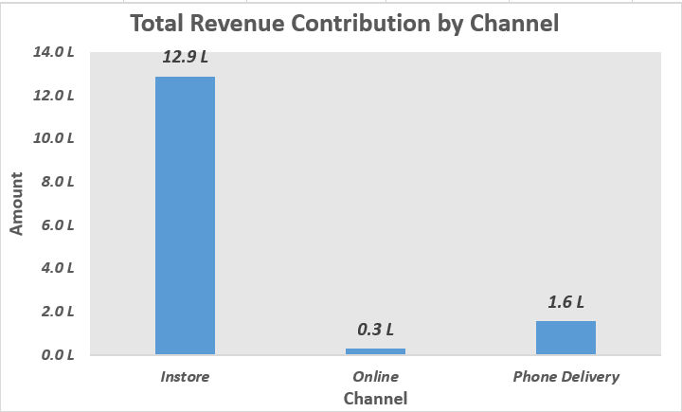
2.Channel-wise Orders
Insight: Order volumes per channel.
Business Value: Channel optimization.

Slide 45
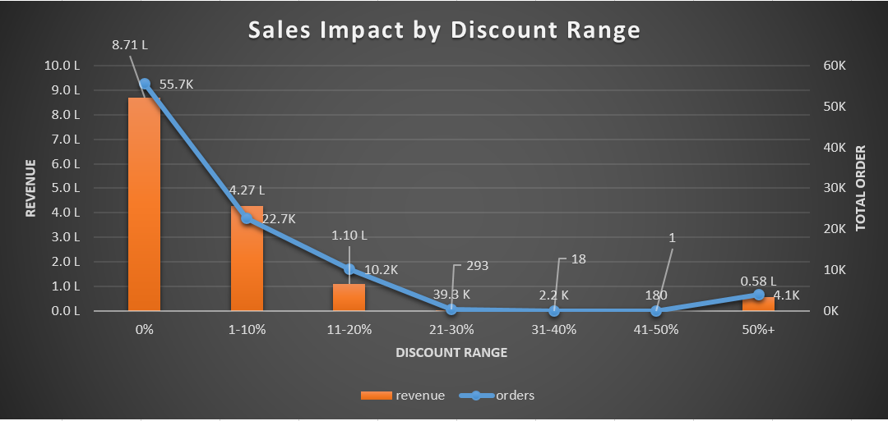
3. Discount Impact Analysis: Orders vs Revenue
Insight: Higher discounts don't always lead to higher revenue — majority of revenue comes from orders with 0% to 10% discount.
Business Value: Helps identify optimal discount slabs that maximize revenue while minimizing unnecessary discounting.
Visuals: Combo Chart

Slide 46
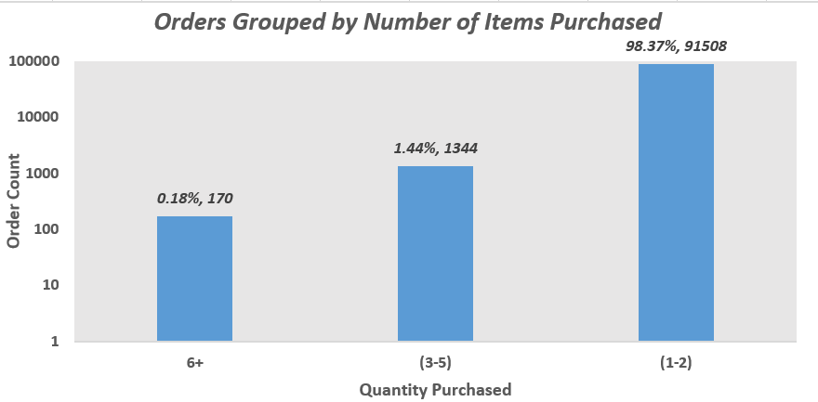
4. Orders Grouped by Number of Items Purchased
Insight: Majority of orders consist of 1–2 items, indicating a preference for small basket sizes among customers.
Business Value : Helps in designing targeted bundling or upselling strategies to encourage higher quantity purchases and increase average order value.
Visuals : Column Chart

Slide 47
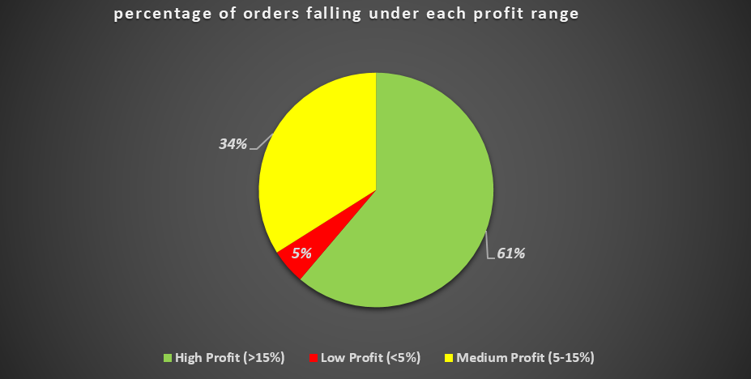
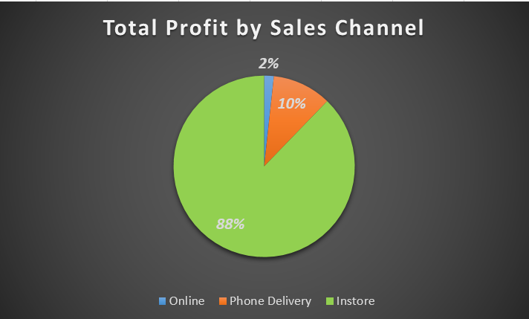
5. Order Distribution by Profit Percentage Range
Insight: Majority of orders (over 60%) fall in the high profit bracket, indicating strong pricing or cost efficiency across key transactions.
Business Value : Supports profit-focused growth by identifying successful segments and enabling replication of high-margin strategies across lower-performing areas
Visual : Pie Chart

Slide 48
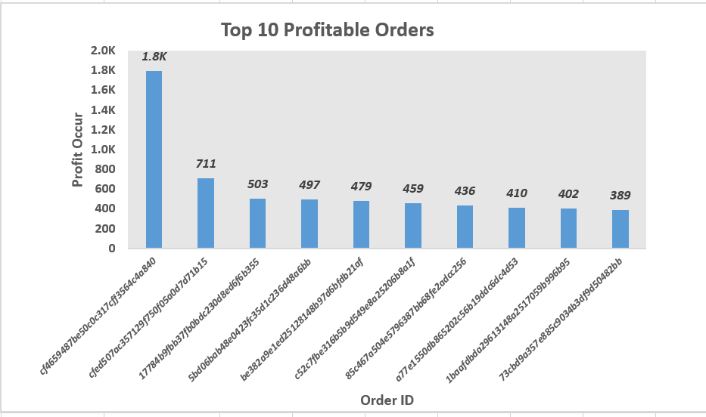
6. Top 10 Profitable Orders
Insight: Shows the orders that earned the highest profit.
Business Value: Helps identify what makes top transactions successful.
Visuals: Column Chart

Slide 49
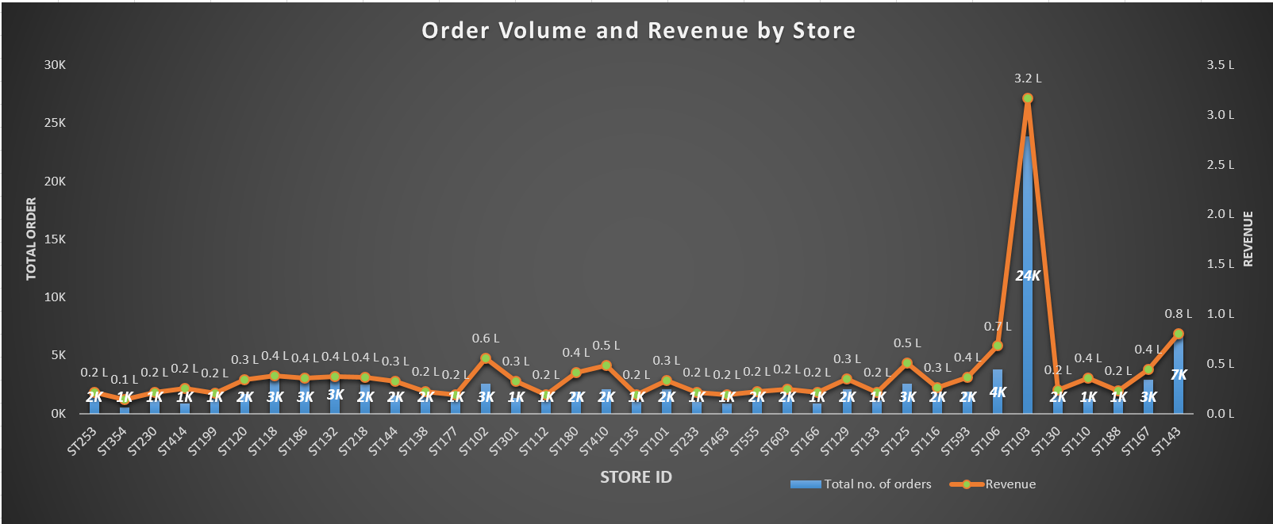
7. Order Volume and Revenue by Store
Insight: Some stores get more orders and earn more money than others.
Business Value : Helps find best and worst performing stores to improve sales and planning.
Visuals: Combo Chart

Slide 50
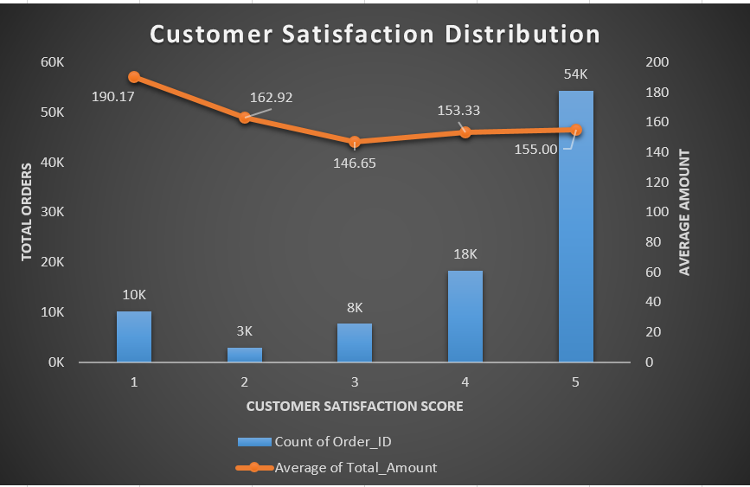
8.Customer Satisfaction Distribution
Insight: Shows how many orders fall under each satisfaction level (e.g., high, medium, low).
Business Value: Helps improve customer service based on feedback trends.
Visuals: Clustered Column Chart

Slide 51
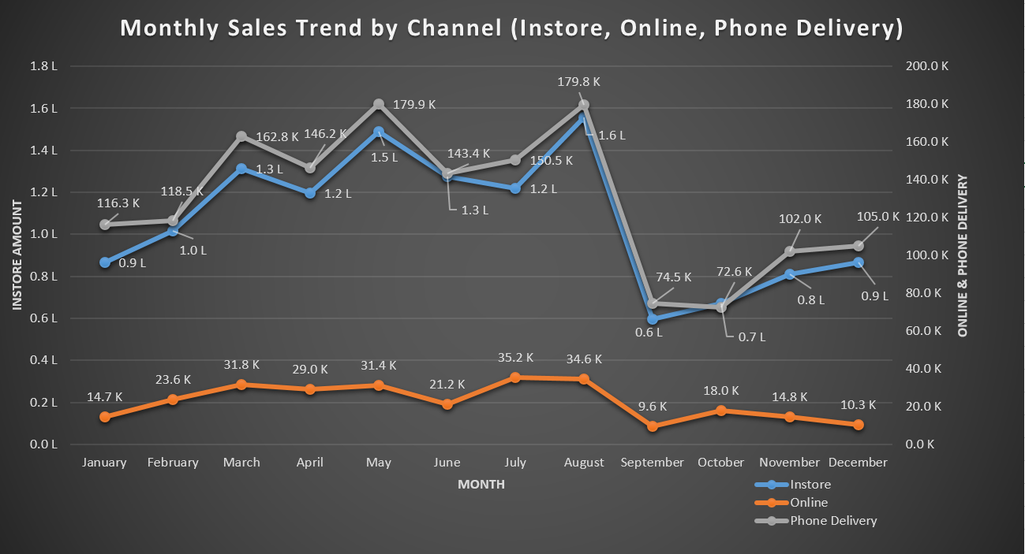
8. Sales by month and channel :
Business Value: Enables data-driven channel optimization to maximize monthly sales performance.
Insights : Reveals which sales channels drive revenue each month, identifying peak periods and underperforming channels.

Slide 52
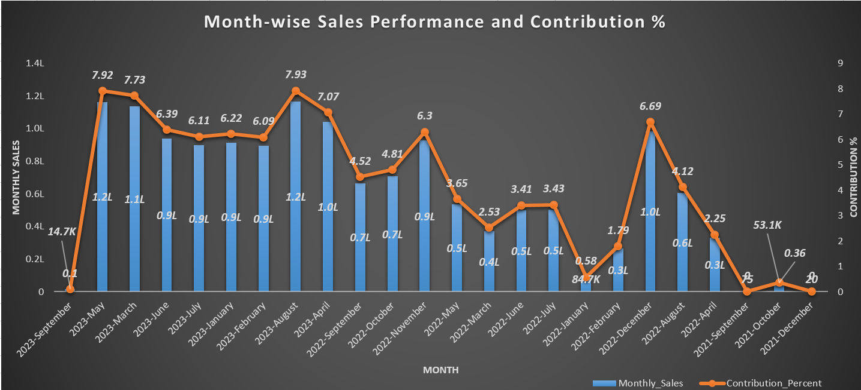
9. Month wise Sales Performance and contribution Percent :
Business Value: Identifying high-performing months helps optimize marketing and inventory planning during peak sales periods.
Insights :Peak sales occurred between March and August 2023, contributing over 40% of total revenue.

Slide 53
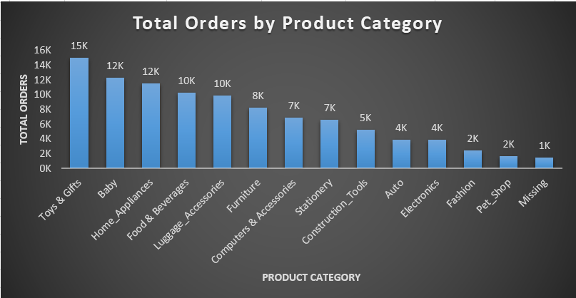
10. Categorywise Highest number of Total orders:
Business Value : Helps identify top-performing categories to focus marketing, inventory planning, and product expansion efforts for maximizing revenue.
Insights :Certain product categories consistently receive higher order volumes, indicating stronger customer preference or demand in those segments.
Visuals : Column Chart

Slide 54
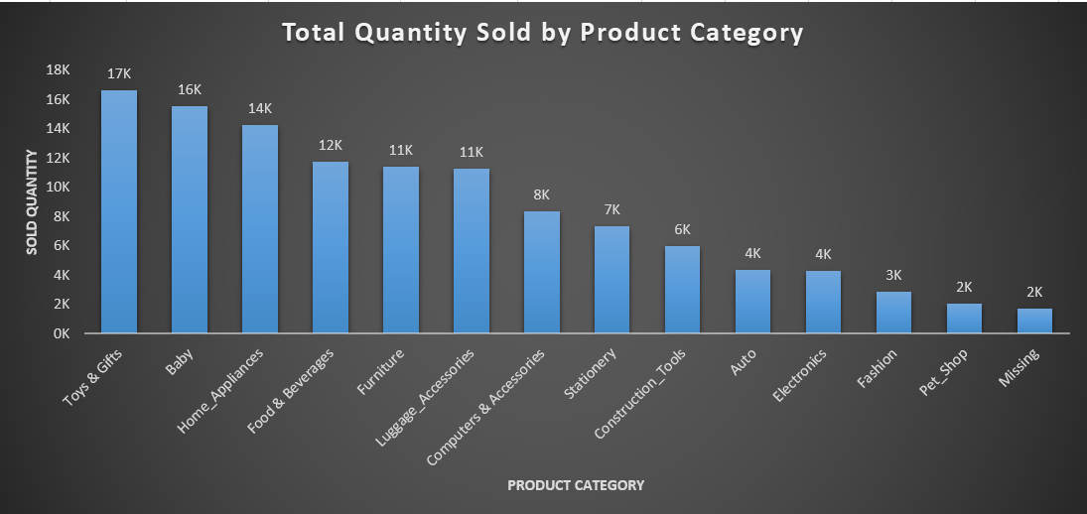
11. Category with Highest Total Quantity Sold:
Business Value :Helps prioritize inventory planning and marketing focus on high-demand categories.
Insights :Toys & Gifts, Baby, and Home Appliances are the top-selling categories by quantity.
Visuals : Column Chart

Slide 55
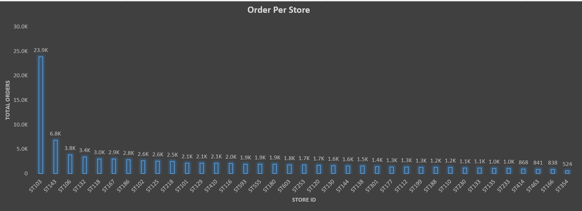
Store Analysis
1.Total Orders per Store
Insight: Order volume per store.
Business Value: Sales performance.
Visuals: Column Chart

Slide 56
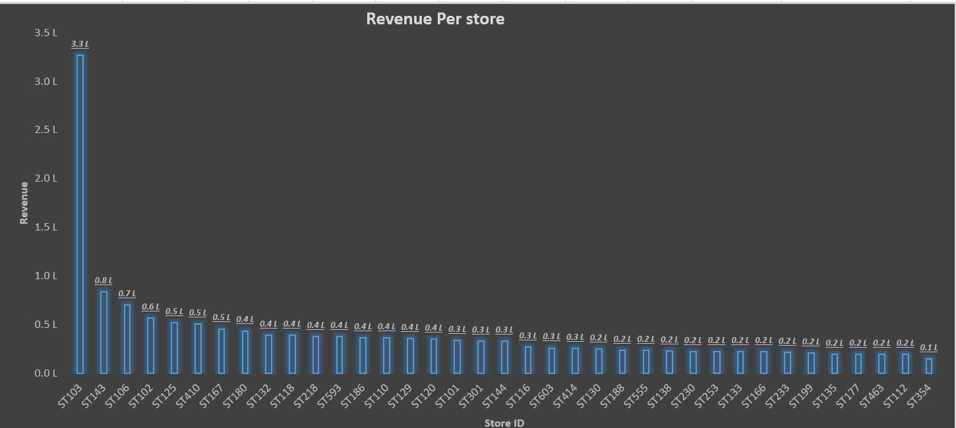
2.Revenue per Store
Insight: Shows how much revenue each store is generating.
Business Value: Helps track and compare store financial performance.
Visuals: Column Chart

Slide 57
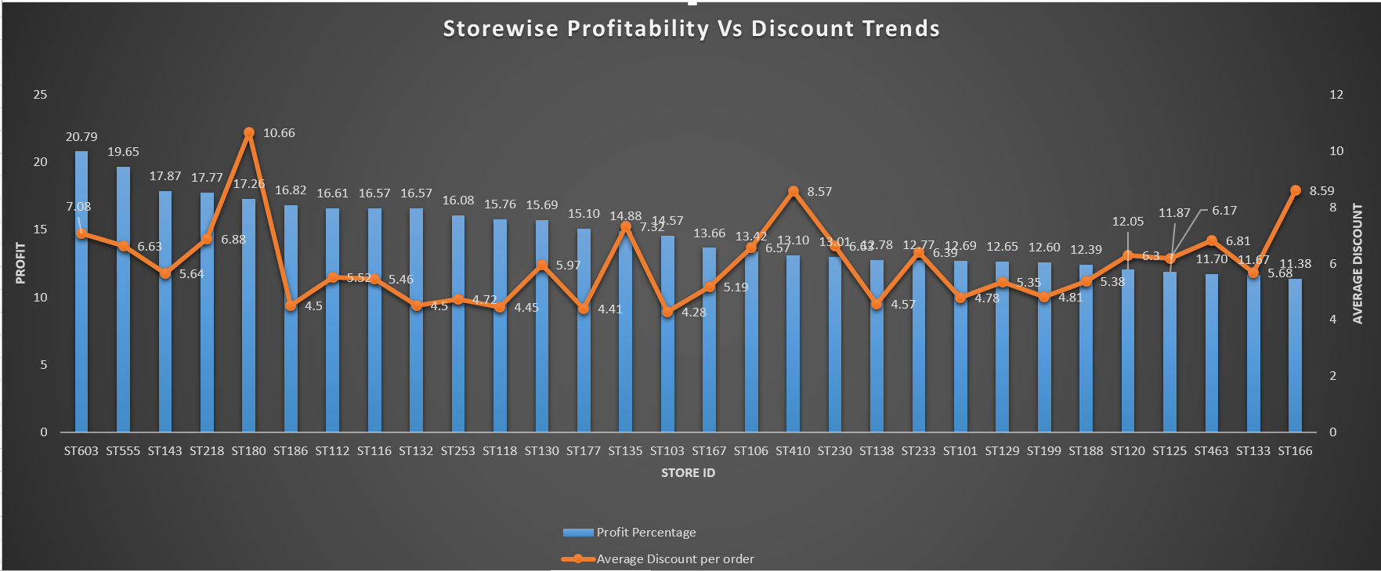
7. Average Discount vs Profit %
Insight: Shows how discounts affect profit margins.
Business Value: Helps review and adjust discount strategies for better profitability.
Visuals: Combo Chart

Slide 58
Cohort Analysis Based on Retention Trends
The majority of customers across all cohorts are one-time buyers, with minimal repeat engagement observed month-on-month.
On average, less than 10% of customers return in any future month, and several cohorts recorded 0% retention.
Only a very small fraction (~0.04%) of customers placed orders in multiple months, highlighting weak repeat behavior.
For those who do return, the average months to repeat ranges between 1 to 6 months, indicating short-term retention.
Cohorts from Feb–Mar 2022 showed slightly better retention, but absolute repeat numbers remained very low.
Overall, the data reflects low customer loyalty, emphasizing the need for stronger post-purchase engagement strategies, such as personalized offers, feedback loops, and loyalty rewards.

Slide 59
Table Column Description
Column Name | Description
Cohort_Month | The month in which a customer made their first-ever purchase. Used to group customers into cohorts.
Cohort_Customers | Total number of new customers acquired in that cohort month (i.e., first-time buyers in that month).
Repeat_Customers | Number of customers from the cohort who made at least one additional purchase in any later month.
Retention_Rate | Percentage of cohort customers who returned and made repeat purchases in future months. Formula: (Repeat_Customers / Cohort_Customers) * 100.
Avg_Months_To_Repeat | The average number of months it took repeat customers to place their next order after their first purchase.
Total_Orders_Cohort_Customers | Total number of orders placed by cohort customers in their first month of purchase (Cohort Month).
Total_Revenue_Cohort_Customers | Total revenue generated from orders placed by cohort customers during their cohort month.
Total_Orders_Repeat_Customers | Number of orders placed by repeat customers after their cohort month (i.e., in repeat months
Total_Revenue_Repeat_Customers | Total revenue generated from repeat purchases by cohort customers after their cohort month

Slide 60
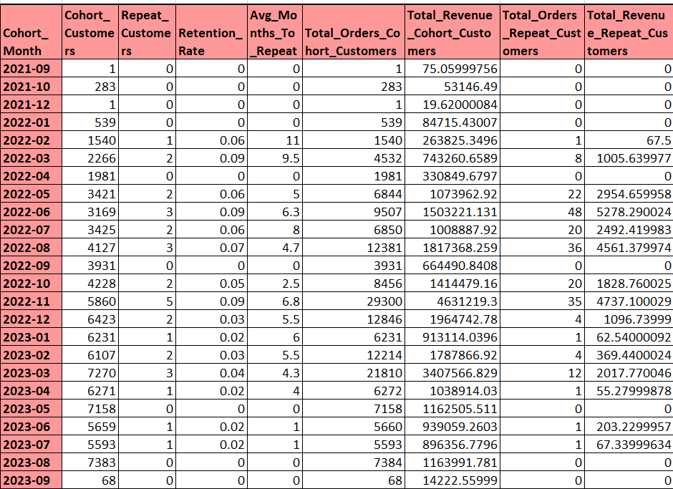

Slide 61
Observations
Low Retention Rate Overall
Most cohorts have 0% to 9% retention, indicating very few customers return to purchase again.
Initial Repeat Purchase Delay
For repeaters, the average time to repeat ranges between 1 to 11 months, suggesting delayed repeat behavior.
Recent Cohorts Lack Repeat Orders
Customers acquired after May 2023 show no repeat activity yet, possibly due to insufficient time for repeat behavior.
Strong Revenue but Weak Retention
Despite high initial revenue (e.g., April 2022: ₹330K, May 2022: ₹1M+), repeat revenue is minimal, showing one-time buying behavior.
Best Performing Cohorts for Retention
March–June 2022 cohorts show slightly better repeat behavior, with up to 48 repeat orders and retention ~9%.
Majority Customers are One-Time Buyers
Over 95% of customers in almost all cohorts have not made a second purchase, a major gap for retention marketing.
High Drop-off Post First Order
Even large cohorts like Nov 2022 (5860 customers) see only 5 repeat customers, emphasizing a steep drop-off.
Revenue Opportunity in Repeat Buyers
Though small in number, repeat customers from March & May 2022 contributed ₹1K–₹5K+, showing their potential value.

Slide 62
Recommendations
Focus on Improving Retention Rate (avg < 10%) Retention rates are generally low—develop engagement strategies like loyalty programs, personalized offers, or subscription models to retain customers beyond first purchase.
Speed Up Repeat Purchases Many customers take 4–11 months to repeat—introduce follow-up offers or reminders within the first 1–3 months to shorten this cycle.
Target High Revenue-Generating Cohorts Cohorts like 2022-08, 2022-11, and 2022-12 contribute significantly to repeat revenue—analyze what worked well during those months and replicate those tactics.
Upsell to Repeat Customers Though small in number, repeat customers bring strong revenue (e.g., 463K in Nov-22, 2017K in Mar-23)—nurture them with premium products or exclusive deals.
Understand Drop-off Cohorts Several cohorts (e.g., 2023-05 to 2023-09) show zero repeat customers—analyze churn reasons via feedback surveys or behavior tracking.
Enhance Post-Purchase Experience To encourage repeats, ensure timely delivery, support responsiveness, and clear communication post-purchase.
Automate Re-engagement Campaigns Use email/SMS automation to re-engage users after their first purchase, especially during the first 2 months.
Segment and Reward Loyal Customers Identify top repeat buyers and offer them incentives (e.g., early access, loyalty tiers, or referral bonuses) to boost retention and advocacy.

Slide 63
Customer Retention Cohort Analysis
This Analysis shows how many customers returned to make repeat purchases in the months following their first order.
Cohort Month = the month when customers made their first purchase.
Month_0 = number of new customers in that month.
Month_1 to Month_12 = how many of those customers returned in the following months.
Conclusion :
Most cohorts have high customer acquisition in Month_0 but very low return rates in the following months.
For example, July 2022 had 3425 new customers, but only 1–2 came back in later months.
Only a few cohorts (e.g., May–August 2022) show slight retention in later months (Month_5 to Month_12).
Recent cohorts (e.g., 2023–2024) don’t show returns yet, likely because not enough time has passed.
At the end we can say while new customer acquisition is strong, long-term retention is weak. There’s a clear need to
improve customer loyalty and engagement strategies.

Slide 64
Table Column Description
Column Name | Description
Cohort_Month | The month when a group of customers made their first-ever purchase.
Month_0 | Number of new customers who purchased in their cohort month.
Month_1 to Month_12 | Number of repeat customers from that cohort who made a purchase in the 1st to 12th month after their first purchase

Slide 65
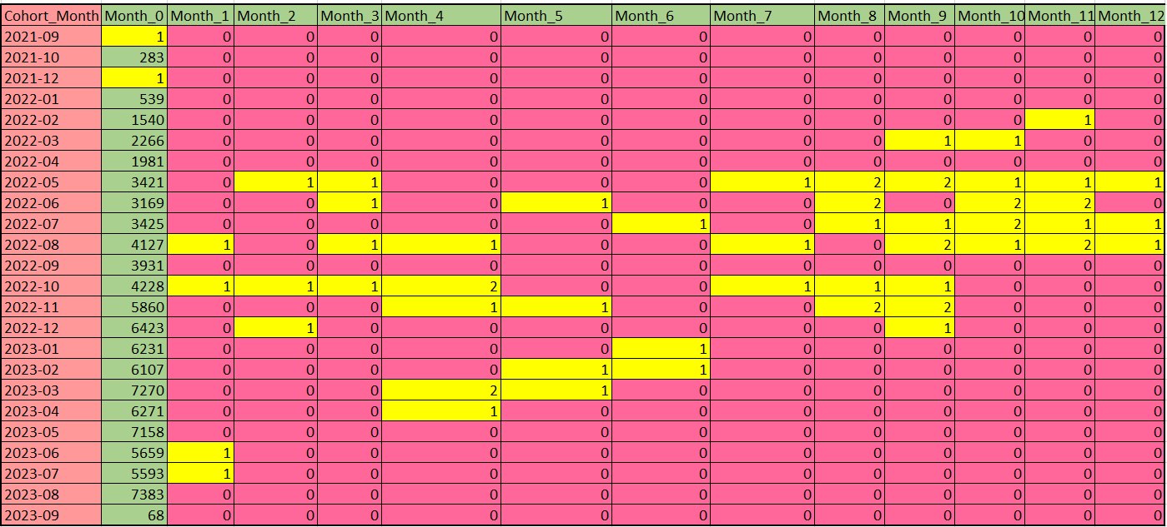
Customer Retention

Slide 66
Observations
Month_0 shows high customer acquisition, especially from 2022-05 to 2023-03.
Most cohorts have zero or very low retention in Month_1 and Month_2.
2022-05 cohort shows the best long-term retention up to Month_12.
2022-10 and 2022-11 cohorts show consistent repeat purchases across multiple months.
Some cohorts (like 2022-04, 2022-09, 2023-05) have no retention at all.
Delayed repeat behavior is seen in certain cohorts (e.g., customers return after 3–6 months).
Recent cohorts (2023 onwards) still need time to show a complete retention trend.

Slide 67
Recommendations
1.Improve Customer Retention Post Month 1: Most cohorts drop off immediately after Month_0, indicating poor early-stage retention—focus on onboarding, follow-up communication, and loyalty incentives in the first 30 days.
2.Leverage High-Retention Cohorts (e.g., 2022-06 to 2022-10): These cohorts show engagement up to Month 10–12—analyze what strategies, campaigns, or seasons contributed to better retention and replicate them.
3.Optimize Re-Engagement Strategies: Introduce targeted email/SMS campaigns, offers, or feedback requests to bring back users who drop off after the first or second month.
4.Strengthen First Purchase Experience: Since Month_0 is the only active period for most cohorts, ensure smooth product/service experience, fast delivery, and quality customer service.
5.Implement Loyalty Programs: To improve multi-month engagement, introduce points-based systems or exclusive benefits for repeat users within the first 3 months.

Slide 68

Dashboard

Slide 69
Dashboard Menu
Theme | Objective | Primary Stake Holder | Daily users
Executive Overview | Show’s the company health at top | CEO | Company leadership
Customer Engagement | To monitor and analyze customer engagement, satisfaction, and churn to improve retention and loyalty. | Marketing head, Customer experience head, CEO | Customer Success, Marketing Analysts, Product Managers, and Support Teams.
Retail Store Intelligence | To analyze retail store performance through orders, revenue, discounts, and customer satisfaction. | Retail Head, Sales Director, and Regional Managers for strategic store-level decisions | Store Managers, Sales Analysts, and Operations Teams for daily performance tracking and actions
Product Level Business Intelligence | To analyze product-level profitability, sales channel performance, and regional order trends. | Product Head, Finance Head, and E-commerce Director for strategic pricing and product decisions. | Product Managers, Sales Analysts, and Category Teams for daily profit and performance monitoring.

Slide 70
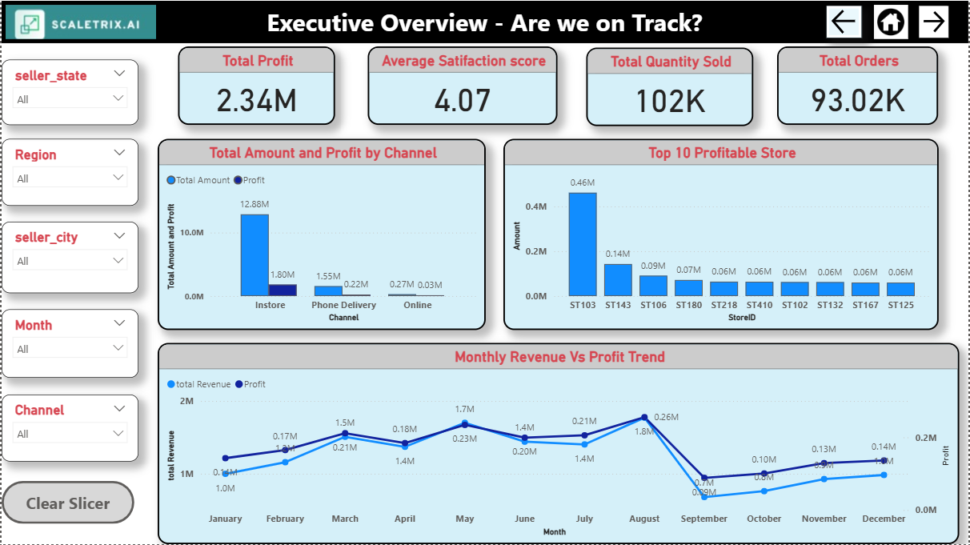

Slide 71
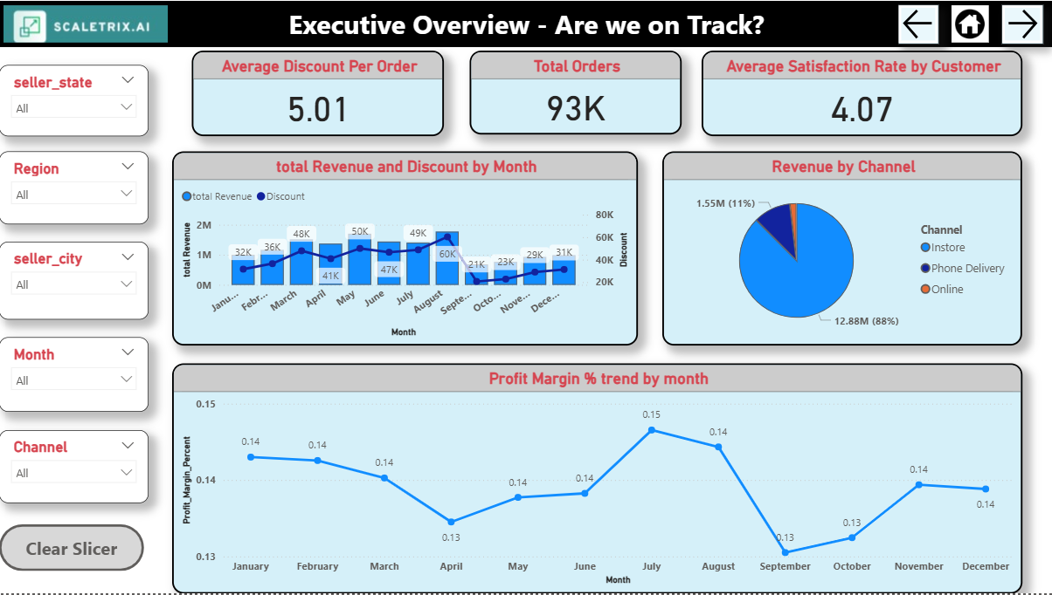

Slide 72
Recommendations
1.Prioritize Customer Satisfaction: Despite revenue growth, satisfaction score dropped from 4.87 to 4.07. Immediate steps needed to identify service/product issues and improve customer experience.
2.Boost Customer Acquisition Efforts: Total customer count remains flat (~93K). :Consider investing in marketing and outreach to tap into new segments or geographies.
3.Leverage High-Performing Regions/Products Identify and replicate success strategies from top-performing states or categories to underperforming areas.
4.Monitor Monthly Fluctuations Closely: Revenue shows seasonal dips. Strategize campaigns or promotions during low-performing months to maintain consistency.
5.Optimize for Retention Over Volume: While orders increased, stagnant customer base suggests repeat purchases. Focus on loyalty programs and post-sale engagement.
6.Align KPIs Across Teams: Ensure sales, marketing, and support teams align goals with executive KPIs—Revenue, Orders, Satisfaction, and Customer Base.
7.Implement Real-time Alerts: Set up alerts for drastic dips in satisfaction or revenue to allow quick executive-level interventions.
8.Explore Automation/Operational Efficiencies: Given rising orders and revenue, assess current capacity. Consider automation or hiring to ensure scalability without compromising service quality.

Slide 73
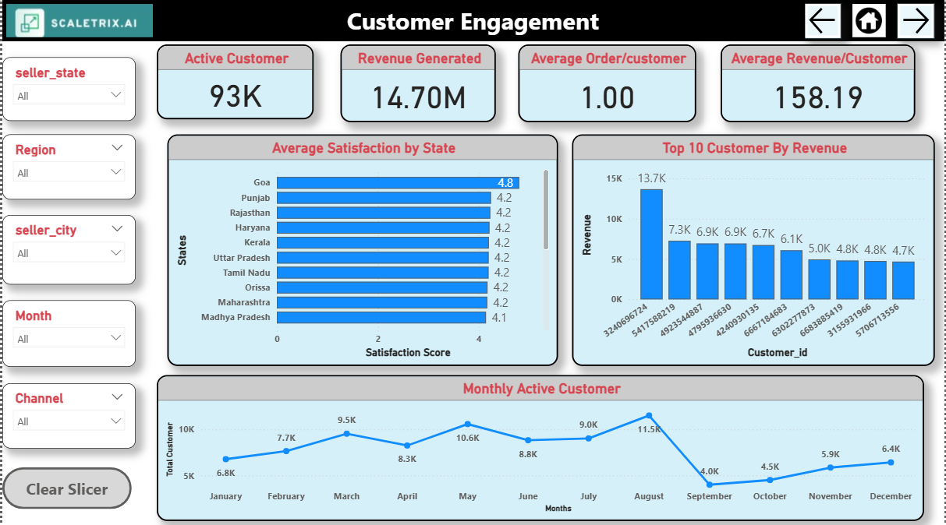

Slide 74
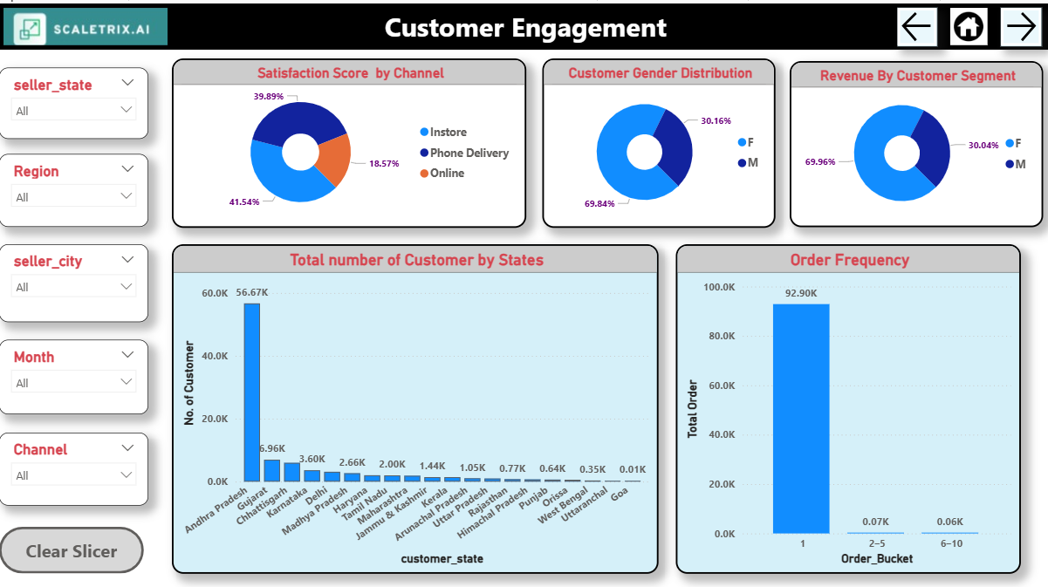

Slide 75
Recommendations
1.Improve Customer Retention: If churn rate is high, identify reasons through feedback and take action to retain customers.
2.Focus on Low Satisfaction Segments: Target specific customer groups with low satisfaction scores to improve overall experience.
3.Personalize Engagement Campaigns: Use insights from customer behavior to send more relevant offers and messages.
4.Track and Act on Churn Trends: Monitor patterns in churn by region or product and address root causes early.
5.Promote High-Contribution Customers: Identify loyal, high-value customers and reward them through loyalty programs or exclusive benefits.
6.Enhance Communication Channels: Improve customer touchpoints (email, chat, calls) based on engagement metrics.
7.Use Dashboard Regularly for Actionable Insights: Encourage daily users (support, marketing, product) to monitor KPIs and take quick action.

Slide 76


Slide 77
Recommendations
1.Increase Repeated Customers: With only 35 repeat customers out of 93K orders, focus on loyalty programs or personalized offers.
2.Optimize Regional Strategies: West region dominates with ~68% orders—explore growth opportunities in underperforming regions.
3.Improve Average Bill Value in Low-Revenue States: States like West Bengal and Haryana show low revenue—run targeted upselling or bundling strategies.
4.Evaluate Discount Impact: Discounts peak in July-August; analyze if this correlates with increased orders or just reduced margins.
5.Boost Satisfaction in Low-Revenue Stores: Scatterplot shows stores with low satisfaction and low revenue—invest in customer service training and store experience.
6.Balance Between Volume and Value: Identify whether high revenue comes from more orders or higher bill per order, and align marketing accordingly.
7.Standardize High-Performing Practices: Study top-performing states/stores and replicate successful tactics in lower-performing ones.

Slide 78


Slide 79
Recommendations
1.Focus on High-Profit Categories: Boost sales of top-performing categories like Home Appliances, Baby, and Toys & Gifts through promotions and visibility.
2.Improve Low-Profit Categories: Re-evaluate pricing, marketing, or demand for underperforming categories like Construction Tools and Computers.
3.Leverage Online Channel Dominance: With ~88% sales online, enhance digital marketing and online user experience further.
4.Optimize Discount Strategy: Discounts peaked mid-year (June–August); assess whether they are driving profitable conversions or cutting into margins.
5.Target High-Value Regions: North region shows highest average order value—explore region-specific marketing to increase profits in other regions.
6.Address Moderate Satisfaction Score: A satisfaction score of 3.91 indicates room for improvement in customer experience or product quality.
7.Analyze MRP vs Profit Outliers: Investigate products with high MRP but low profit margins for pricing or cost improvements.
8.Encourage Cross-Selling & Bundling: Promote product combinations in high-profit categories to increase overall average order value

Slide 80
THANK YOU!

